Slide 1
Large language models
Light overview
Andrew Banks

Slide 2
Definitions
Temperature
How much the model can “hallucinate”. You want a higher temperature for more creative tasks.
Transformer
What LLMs are built from. The architecture comes from Googles “Attention is all you need” paper. They work by calculating “attention” between tokens
Inference time
The time it takes for the model to predict the next token.
Autoregressive
The output of a model is fed into itself repeatedly.
Parameter/weights
A variable that adjust the output of a neuron in a neural net. These variables are trained with the training set .

Slide 3
Definitions
LLM
Large language model
Context
The tokens that a LLM is currently predicting on
Token
Represents a single instance of data our model
Token-limit / context-limit / context-size
The maximum number of tokens a LLM can predict on
Embedding
Vector representation of our data/token.
Embedding matrix/vocabulary
Represents all possible vocabulary/tokens that a LLM can output
Hallucination
LLM’s will occasionally focus more on sounding grammatically correct rather than being factually correct

Slide 4


What is a large language model?
A machine learning model trained on a massive amount of text, that can be used to generate text
They generate text word by word, until an “end token” is generated.
The model is rerun for every token
Also known as foundational models
Notes:
Generating text word by word is also known as causal language modeling.
The text generation is autoregressive. After generating a token, we feed our new context, with our new token, and generate the next one. Repeat until we generate an end token.
We’ll take a look at gpt. Regarding generating text word by word. Note that these base models are NOT made to chat with a user in mind. The way they work is that they are trying to complete of the text that was passed in.

Slide 5
Use cases
Situation that requires a large amount of conditionals
QA chatbot on local data
Story/Dialogue generation
Programming help
Text summarization
Notes:
Programming help for example github copilot is based off of an llm
QA chatbots can be made by storing documentation in a vector database, or if there is enough context, just storing the docs in the prompt itself.
Dialogue and story generation works by prompting the model to roleplay.
Text summarization is just to tell the model to summarize something…

Slide 6
Potential issues
Hallucinations
Math
Expensive
Understanding vs mimicking..?
Notes:
Hallucinations occur because of …
Furthermore, the model will KNOW its wrong, but would rather follow an output that follows the flow of grammar, rather than being actually correct.
Something interesting to think about hallucinations though is the idea of grounding truth. Stories and games will have different versions of grounded truth.
- Some ways people try to solve this issue when searching is to first query the search result, and then ask chatgpt to summarize the provided search result. This will result in less hallucinations, as the source of truth is within the context.
IT IS NOT A CALCULATOR. They answer to a math problems by predicting the next token.
Large language models don’t truly understand language. Fluid responses could be generated without a full understanding of context.
- HOWEVER, there is a huge argument about this at the moment, and some researchers do believe that when you slam enough parameters, the models understand. I don’t know. Tbh, there are people that say that understanding is an emergent behaviour in GPT4. im not a researcher, so I cant claim anything
Expensive: They are expensive both in cost, and compute resources, and time to train. Training foundational models can cost multiple millions, and take months
As they predict one token to the next, they are not good at knowing when a prompt will end.
- Ask it to come up with a palindrome using a certain word such as racecar, and it will probably fail. The palindrome doesn’t have to be correct either.

Slide 7
Tokens
The unit of data LLMs operate on. It is a piece of a much larger text
The process of splitting input into a list of tokens is called “tokenization”
A simple tokenization process would be to make every word in a sentence a token
Notes:
Tokens are the units of data that LLM’s operate with. They are pieces of a larger text
Tokenization is the process of splitting an input into a list of tokens. The main types are
Byte pair encoding (BPE)
WordPiece
SentencePiece
The tokens are then assigned a specific id, which is then sent to the embedding table to generate an embedding.
There are many tokenization strategies. One example is just converting every word into a token. But this doesn’t have to be the case. Some strategies will create fixed length tokens…

Slide 8
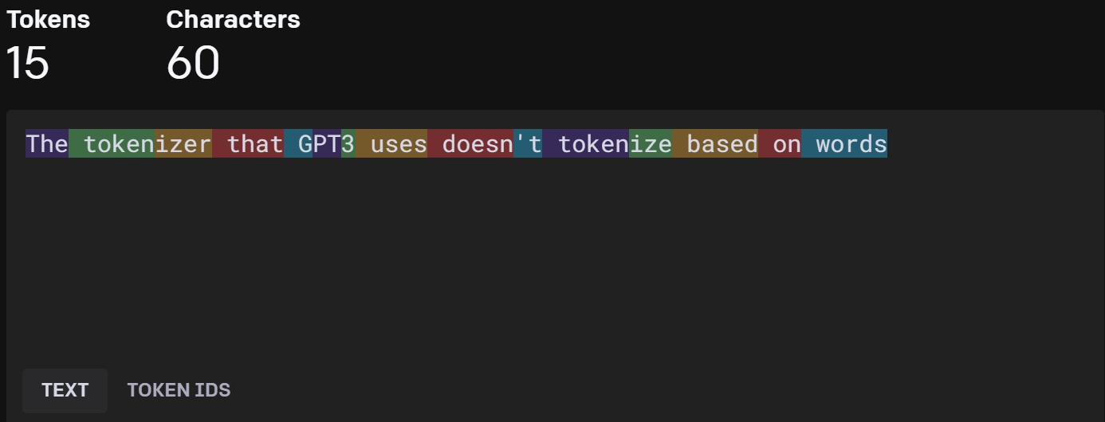
Tokenizer example
https://platform.openai.com/tokenizer
Notes:
https://platform.openai.com/tokenizer
The above is a sentenced that that was tokenized with the tokenizer used in GPT3
The tokenizer used by GPT3 doesn’t tokenize by word, and the average token length will be around 4 – 6 characters.

Slide 9
Embedding
An embedding vector is a numerical representation of a token
The embedding is encoded with information such as contextual information, meaning, etc.
Tokens that occur in similar contexts will usually have similar embedding representations.
A token is converted into an embedding through a separate embedding model.
Notes:
Embeddings are numerical representations of our tokens
With these numerical representations of our tokens, LLMs are able to find relationships between tokens in a sentence, or context size.
- The information encoded into the embedding vector is learned through training. Information such contextual information, meaning are usually learned.
Tokens that are similar, for example, apple and banana, would end up with a similar embedding representation. This also means that within the embedding space, they would be close to eachother
Tokens are converted into embeddings with an embedding model.
The embedding size is considered a hyper parameter. Aka how many properties can we attach to a token.

Slide 10
Embedding
Each dimension/cell represents a property of the token.
0.125
0
0
0.25
0.6
0.025
…
0.1
0.1
0.1
0
0.5
0.2
…
…
…
Notes:
In this example, maybe the first element in the embedding vector represents the concept of food. It could also represent its part of speech.
- This is a black box, as the embedding model decides what these properties are…

Slide 11
Temperature
Temperature could be thought of a creativity lever.
Higher temperature means the model will have more potential next tokens.
Lower temperature means the model will be more deterministic.
Notes:
- Temperature could be thought of a creativity lever.
- Higher temperature means the model will have more potential next tokens.
- Lower temperature means the model will be more deterministic.
Temperature is used when deciding the next token is calculated. Given a softmaxed probability distribution over the vocabulary, we do the following.
With random sampling, if there were 2 potential next words, such as “water”, and “juice”. If water had a .6 score, and juice had a .4 score, that would mean we would choose water 60% of the time and juice 40% of the time.
A temperature of 1 would sample the distribution as is, its more diverse. HOWEVER, the closer the temperature is to 0, the model becomes more deterministic. Basically this would make water have a higher chance of being chosen and juice would be even LOWER

Slide 12
I got sick drinking very sour ____
Temperature of 1
Temperature of 0.01
Milk | Lemonade
.7 | .3
Milk | Lemonade
.98 | .02
Notes:
Depending on temperature, the model is more deterministic. The probabilities in this slide are completely made up. Just know that they add to 1.
If someone asks, also mention that there are multiple ways to sample the end distribution, whether its greedy decoding, or random sampling, or if your fancy, beam search!

Slide 13
High level overview
The LLM takes in a list of tokens
Every input token is converted into an embedding
The LLM works with the embeddings to produce a final distribution over the embedding matrix / output vocabulary.
The next token produced by the LLM is chosen from the probability distribution over the vocabulary.
Repeat until end token is predicted/generated by the model
Notes:
The vocabulary is also known as an “embedding matrix.”
LLM’s predict a token when provided a sequence of tokens. This continues until an “end token” is generated.

Slide 14
Context size
Due to how language models work, they are only able to process up to a fixed number of tokens at a time.
Context size seems to range from 2400 tokens to around 80,000 tokens, depending on model architecture.
Notes:
Context size is the amount of tokens a model can input at a time.

Slide 15
Some prominent large language models
GPT
CLAUDE
LLaMA
Palm-2
Notes:
OK. Transformer is what LLMS are based off of. I didn’t mention it because I don’t really know how to mention it without being a brain dump
Claude is anthropics
Gpt is open ai
Palm2 is google
Llama is meta.
LLAMA is also the only open source model at the moment.

Slide 16
GPT
“Generative Pretrained Transformer”
The model that powers Chat-GPT
GPT4
Context size: 32,768 tokens
English words: ~24000
MultiModal(internal only)!
GPT3.5-turbo
Context size: 4096 tokens
English words: ~3000
Notes:
This is closed source

Slide 17
LLaMA
Llama is an opensource foundational model from Meta.
Meta also provided variable parameter versions of LLaMa, enabling the ability to run them on low VRAM hardware
Comes with varying number of weights/parameters: 7B, 13B, 33B, 65B
B here is billion parameters/weights
Almost all current opensource models are modifications of Llama, as it was the first opensource model that worked good enough™

Slide 18
LLaMA optimizations
Lora(Low Rank Adaptation) is a way to “fine-tune” LLM’s that doesn’t require a large amount of GPU’s, and can be done with cheap hardware
Quantization is a technique that reduces the precision of floating point numbers. This can reduce the model size
Notes:
Lora’s work by first freezing the pre-trained weights, and then projects the parameters/weights into a smaller space. And then training that smaller space only. The smaller space is then projected back to the regular size. This smaller space has less weights to train. Loras work with the idea that most weights are useless in the model, so reducing dimensionality shouldn’t affect the output too much.
Quantization is a technique that reduces the precision of the floating point numbers that store the model parameters, resulting in smaller model size and faster inference speed. Example is turning FP32 to int4
The goal here is to decrease granularity while still maintaining solid performance
Quantization can be done at different levels, such as int4 (4 bits per parameter), int3 (3 bits per parameter), or int2 (2 bits per parameter). The lower the level, the more compression and speedup, but also the more potential loss of accuracy.
There are multiple attempts at quantization at the moment.
There have been efforts to combine both of these methods, such as Qlora.

Slide 19
Quick note on LoRa’s and finetuning
LoRa’s are usually trained to focus on a specific style of text
This does not take up context space
You can greatly modify the output of your LLM with prompting
This takes up context space
Finetuning a foundational model is incredibly expensive
Notes:
Specific style of text in this case could refer to story telling, acting as a chat bot, or being a dungeon master in DND.
Prompting is INCREDIBLY important, however, it takes up context

Slide 20
Llama model examples
LLaMa 7B
VRAM required: 9.2GB
LLaMA 7B quantized to 4bit with AutoGPTQ
Vram required: 6GB
Notes:
There are currently different styles of quantizing the parameters/weights of these models. So there’s a ton flying around. The current SOA is exllama, but this could change by the time I present these slides
Using GPTQ, you could run some models such as LLama33B on a cpu

Slide 21
Developing with LLMS
Vector databases
Semantic kernels

Slide 22
Vector databases
Vector databases can store, index, and search across massive datasets of unstructured vector data (embeddings)
Vector search is usually done using ANN
Similarity could be calculated with cosine similarity or L2 distance
If there aren’t many vectors, a naïve O(n) search could be faster in a relational DB
Notes:
Vector databases are fully managed solutions for storing, indexing, and searching across a massive dataset of unstructured data that leverages the power of embeddings from machine learning models¹.
They are designed to store and retrieve high-dimensional vectors efficiently and accurately.
The return result of a query is usually is a list of vectors, with a distance score.
Cosine similarity: https://en.wikipedia.org/wiki/Cosine_similarity
L2 distance similarity: https://en.wikipedia.org/wiki/Cosine_similarity
ANN represents “approximate nearest neighbors”. A faster but less accurate version of KNN. Some example algorithms are
Why is Vector Search so fast? | Weaviate - vector database
Examples of ANN methods are:
trees – e.g. ANNOY (Figure 3),
proximity graphs - e.g. HNSW (Figure 4),
clustering - e.g. FAISS,
hashing - e.g. LSH,
vector compression - e.g. PQ or SCANN.

Slide 23
Vector databases
Milvus
Open source, FAST
Weaviate
Open source, go based, semantic search, multiple API support
Rest, GraphQL
Pinecone
Commercial
Operates on GCP or AWS
FAISS (Facebook AI Similarity Search)
Not really a database, but provides similarity search for vectors

Slide 24
Langchain
Langchain can be used to interact with LLM in a programmatic way and “chain” LLM’s together. Currently only supports python….
The goals of langchain are
1. “Be data-aware: connect a language model to other sources of data”
2. “Be agentic: Allow a language model to interact with its environment”
Microsoft has semantic kernel which works very similarly
Notes:
LangChain is a framework for developing applications powered by language models.
🦜️🔗 LangChain | 🦜️🔗 LangChain
Tool: “A specific abstraction around a function that makes it easy for a language model to interact with it. Specificlaly, the interface of a tool has a single text input and a single text output.”
Agents: “The language model that drives decision making”
Toolkits: “sets of tools that when used together can accomplish a task”
Agent executor: “the logic for running agents with tools”

Slide 25
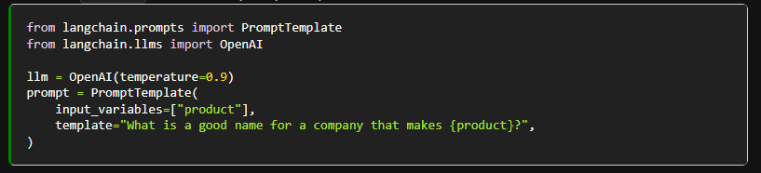
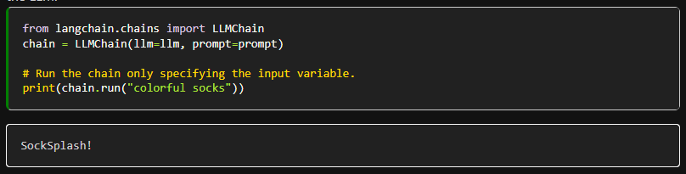
Langchain: Chains
Chains can be used to accomplish a common use case.
The flow of logic is predetermined.
Notes:
The most commonly used type of chain is an LLMChain, which combines a PromptTemplate, a Model, and Guardrails to take user input, format it accordingly, pass it to the model and get a response, and then validate and fix (if necessary) the model output.
In this example, we first set the template for the prompt. This is the samething as typing text into chatgpt.
With langchain however, I can pass in variables, in this I want to pass in a product.
The second part is actually creating the chain with a specific prompt template “the one I just made” and a large language model. In this case, this is using gpt3.5.
When chain.run is called. It calls asks gpt3.5”What is a good name for a company that makes “colorful socks”?
And the chain ends up returning SockSplash!

Slide 26
Langchain: Agent
Agents are useful when the code path may not be predetermined.
This could occur if we need to use different chains depending on user input.
These type of “chains” have an “agent” that can be used solve the problem
Actions an agent do can either be using a tool and observing its output, or returning a result to the user
Notes:
In these types of chains, there is a “agent” which has access to a suite of tools. Depending on the user input, the agent can then decide which, if any, of these tools to call.

Slide 27
Langchain: Tools
You can create your own custom tools, or use tools provided by the opensource community
Tools are akin to plugins in Chatgpt
https://python.langchain.com/en/latest/modules/agents/tools/getting_started.html
Notes:
Tools include wolfram alpha, terminal access, google search, ETC

Slide 28
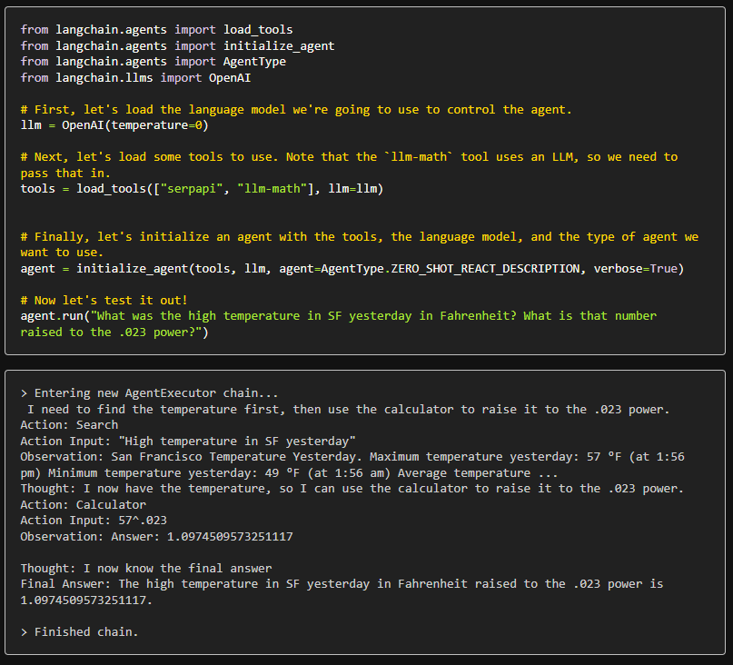
Notes:
In this example, we create an agent that has 2 tools. Serpapi “a wrapper around internet search” and llm-math, a tool that the agent can use to do math problems.
We are also using the openai gpt3.5 llm
And we set the agent type to agetntype.zero_shot_react_description. This is the default one. What this agent type does is when the prompt is getting processed, the agent will use an llm to determine what tools it needs to get to the answer.
Looking at the output, you can see the reasoning process of the llm to arrive to the conclusion

Slide 29
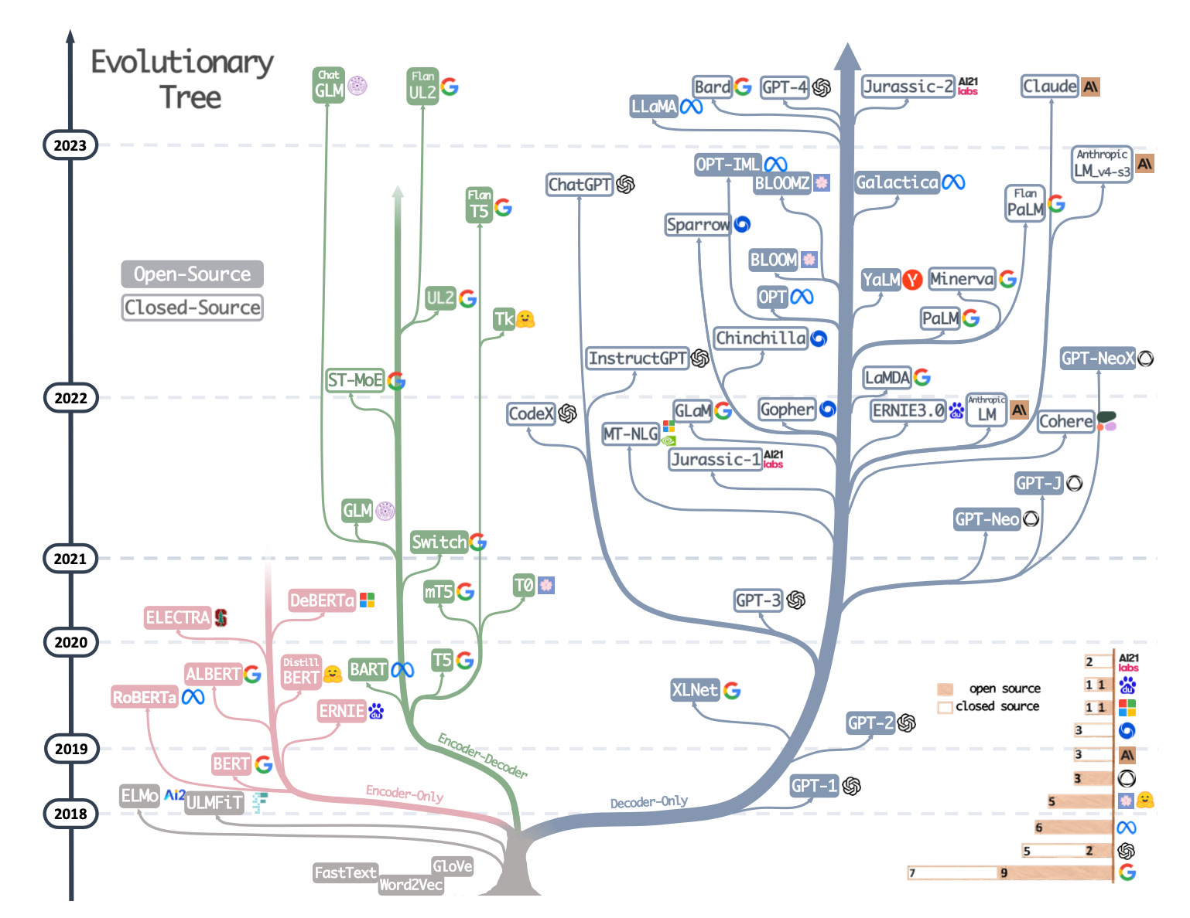
Current models in the space.
Cloud based/proprietary:
GPT4
GPT3 / 3.5
Bard / Palm2
Locally runnable:
Facebook Llama
Alpaca
gpt4Xalpaca
supercot
Vicuna
Wizard
Stability ML

Slide 30
Interesting developments with LLM’s
Auto-GPT
An agent that can recursively call agents to complete tasks.
Characterai/tavernai
A platform that allows users to set the behavior, setting, and other personality features of a chat bot. Useful for role playing and character simulation
Chatgpt
A wrapper over GPT3.5 and GPT4 that is quite capable as a chat bot
GPTQ
Quantization of models parameters, enabling the model to run models on cheap hardware such as raspberry pi
Vicuna/Cerebras/alpaca
Popular open source models that are quite capable (around GPT3.5 level), and locally runnable. Built off of facebook llama
LoRA
Reduces the memory required to run “finetuned” models. Also trains much faster.
It may be possible to merge these with quantized models! Currently active research
Claude
Model with 100k token context limit.
Owned by anthropic.
For comparison, Gpt3.5 has a 4096 token limit and GPT4 has 32768 token limit
Notes:
Autogpt currently has 124k stars
Systems such as tavernai could be useful in the creation of NPCs for game development.
Characterai is closed source where as tavernai is open source. It is usually run on a system called oobabooga
Chatgpt is chatgpt
LLMfrontends. These are wrappers around llms.
This slide will be updated before

